Slide 1


模拟电子技术基础
Analog Device
3.4 FET Amplifier Circuit
场效应晶体管放大电路
(Chapter 2.6)
Qingfeng Zhang 张青峰
Department of Electrical and Electronic Engineering

Slide 2
Transfer curve 转移特性曲线
i_{D}
Enhanced NMOS
Depleted NMOS
N-type JFET
U_{GS(off)}
0
U_{GS(th)}
u_{GS}

Slide 3
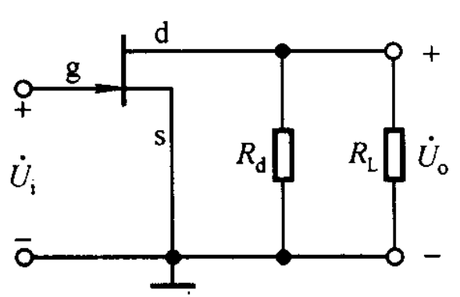
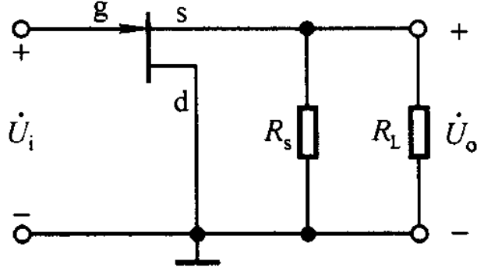
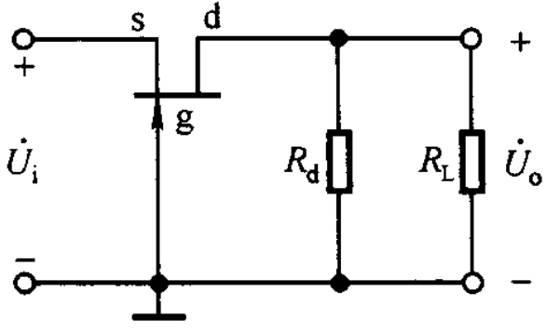
3.4.1 Common-s, -d, -g amplifier
Common-s
Common-d
Common-g
We mainly focused on common-s and -d circuit, since common-g is less used in amplifier circuit
Self-biased circuit自给偏压电路
Voltage divider biasing circuit 分压式偏置电路

Slide 4














3.4.2 Self-biased circuit自给偏压电路
N-type JFET
Static analysis
+
d
+
d
+
g
g
s
s
+
+
_
_
No direct voltage supply on gate.

Slide 5







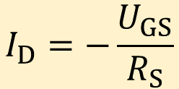






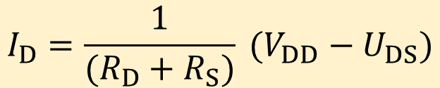
Static analysis
1) Graphic method 图解法
Input circuit:
d
g
s
Output circuit:

Slide 6
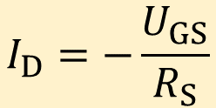







I_{D}
I_{D}
u_{GS}=0V
I_{DSS}
U_{GS1}
U_{GSQ}
U_{GS3}
U_{GS(off)}
U_{GS(off)}
0
U_{GS}
U_{DS}
U_{GSQ}<0: Self-biased circuit is suitable for JFET and depleted MOSFET

Slide 7




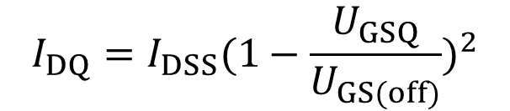






2) Approximation method 估算法
Input circuit:
d
g
s
Output circuit:

Slide 8






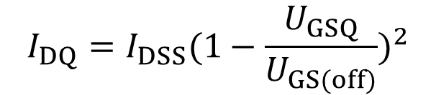
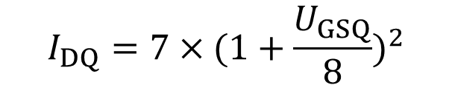










Q1: As shown in the figure, V_{DD}=18V, R_{D}=3kΩ, R_{S}=1kΩ and R_{G}=1MΩ. FET has I_{DSS}=7mA and U_{GS(off)}=－8V. Ask: the value of U_{GSQ}, I_{DQ} and U_{DSQ}.
Answer:
Input circuit:
d
g
s
Output circuit:

Slide 9



















3.4.3 Voltage divider biasing circuit
Enhanced N-type MOS
Static analysis
+
d
+
d
+
g
g
s
s
+
_
_

Slide 10


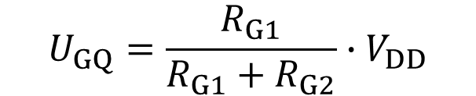







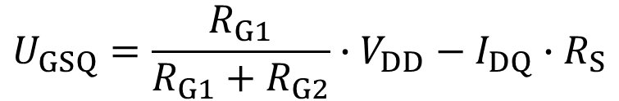






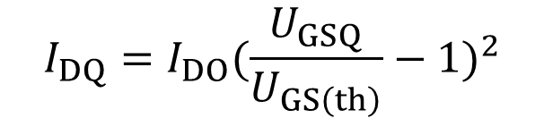



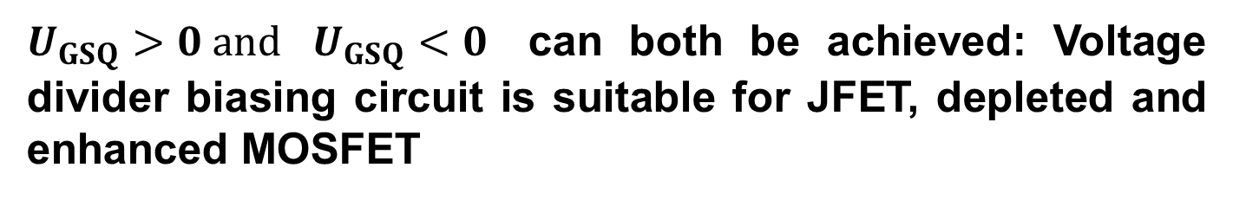
Static analysis
d
g
s

Slide 11
3.4.4 Dynamic analysis of FET amplifier circuit
Find the equivalent circuit of FET: to replace FET with a linear network
Transistor
Equivalent circuit
i_{G}=0
i_{D}
i_{G}=0
i_{D}
+
d
+
+
+
Linear
Network
u_{GS}
FET
u_{GS}
u_{DS}
u_{DS}
g
–
–
–
–
s

Slide 12


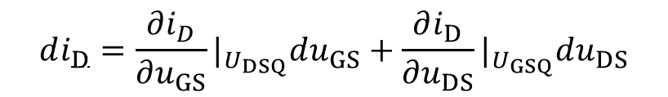
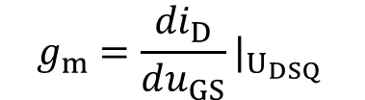
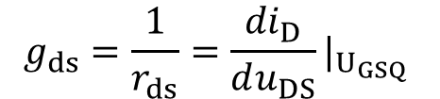
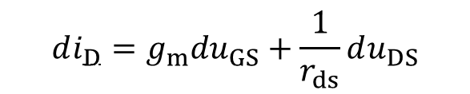
1
2
i_{G}=0
i_{D}
+
+
Transconuctance g_{m} 互导/跨导
Linear
Network
u_{GS}
u_{DS}
–
–

Slide 13
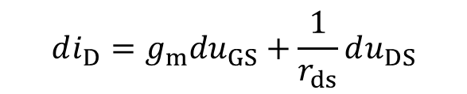

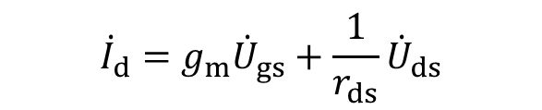










Input signal i_{D} is small
小信号条件
d
g
d
g
s
s

Slide 14

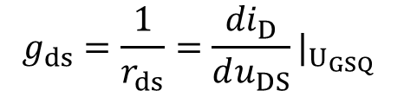













i_{D}
U_{DS}
Simplified model
g
d
g
d
s
s

Slide 15











High frequency model
g
d
s

Slide 16

















Common-s amplifier circuit
AC circuit
d
+
g
s
+
+
d
+
+
g
s
_
+
_
+
g
d
_
_
+
+
+
N-type JFET
_
_
Self-biased circuit
s
_

Slide 17


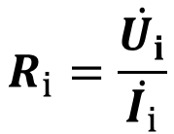










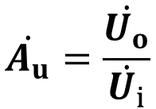










g
d
Input resistance：
+
+
+
_
_
Output resistance：
s
_
g
d
Voltage gain：
+
+
_
s
_

Slide 18

















Common-d amplifier circuit
AC circuit
d
g
s
+
d
+
+
g
s
+
+
+
_
_
_
g
d
_
+
+
_
N-type JFET
s
+
Self-biased circuit
_
_

Slide 19
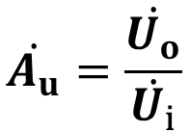











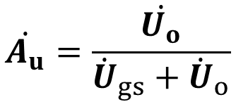

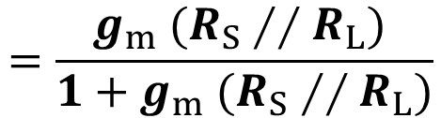








g
Voltage gain：
d
+
+
_
s
+
_
_
g
+
+
_
s
+
Input resistance：
_
_
d

Slide 20
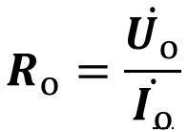








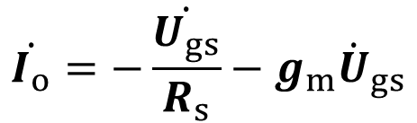
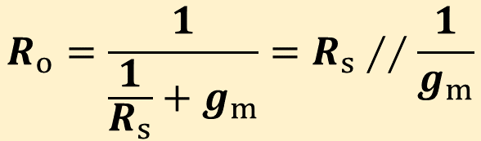
Output resistance：
g
+
_
s
+
_
d

Slide 21























Common-g amplifier circuit
AC circuit
s
d
s
d
g
g
s
d
Enhanced N-type MOSFET
g
Voltage divider biasing circuit

Slide 22
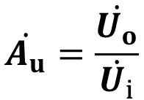










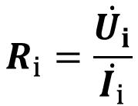





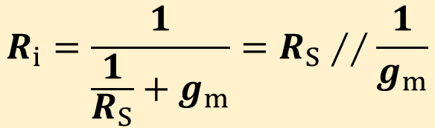

s
d
Voltage gain：
g
s
d
Input resistance：
g

Slide 23








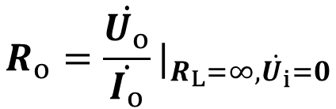










s
d
Output resistance：
g
s
d
g

Slide 24
Homework 3-1：2.16

